Slide 1
Product Sales Report
Mini Project on Power Bi Dashboard

Slide 2
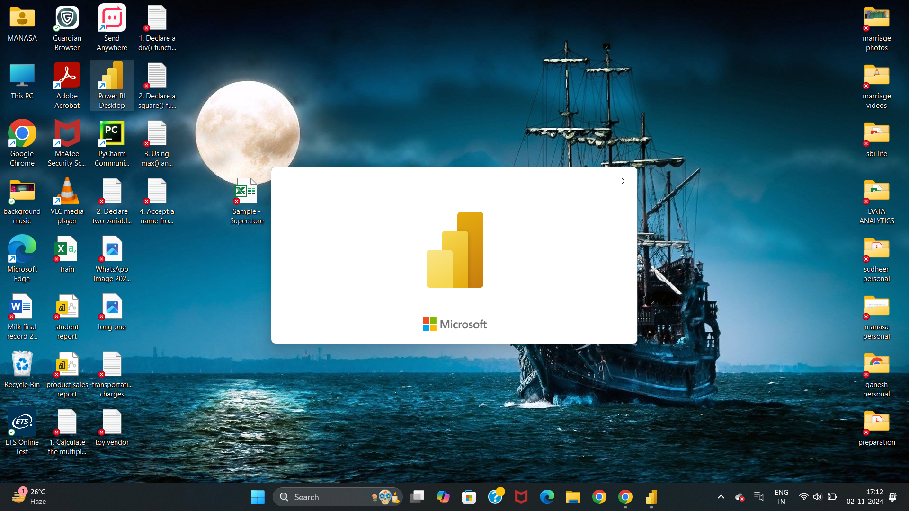
Click on power bi desktop app to open

Slide 3
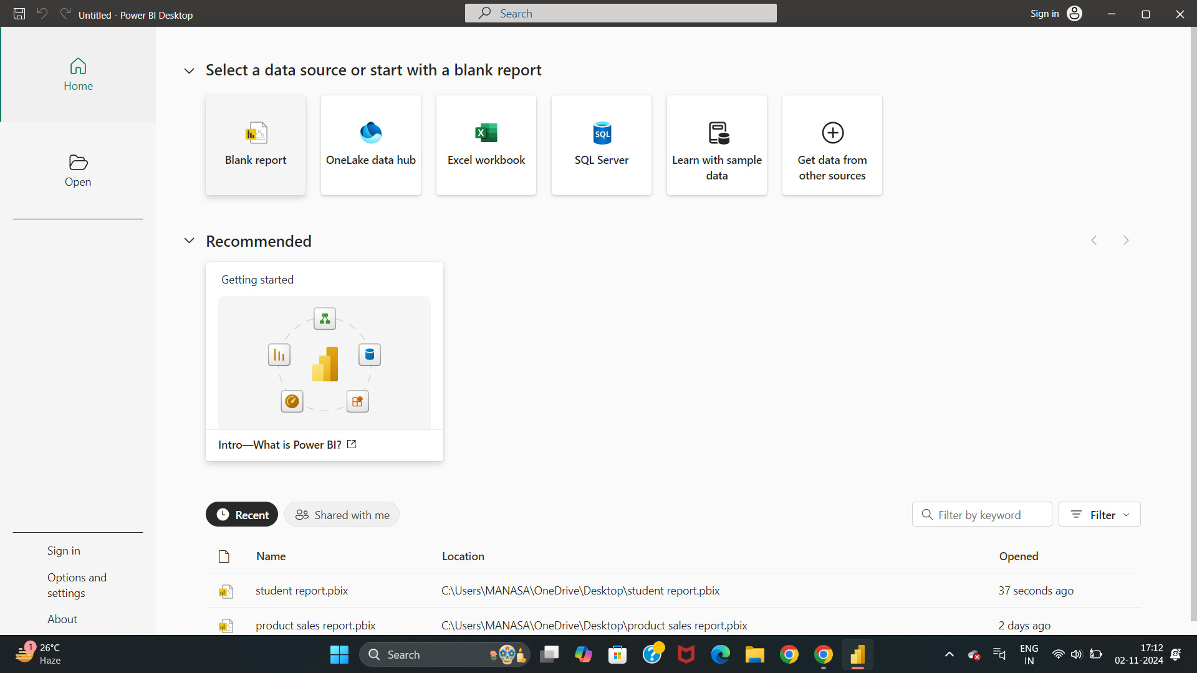
Click on Blank Report to create a power bi to create a dashboard

Slide 4
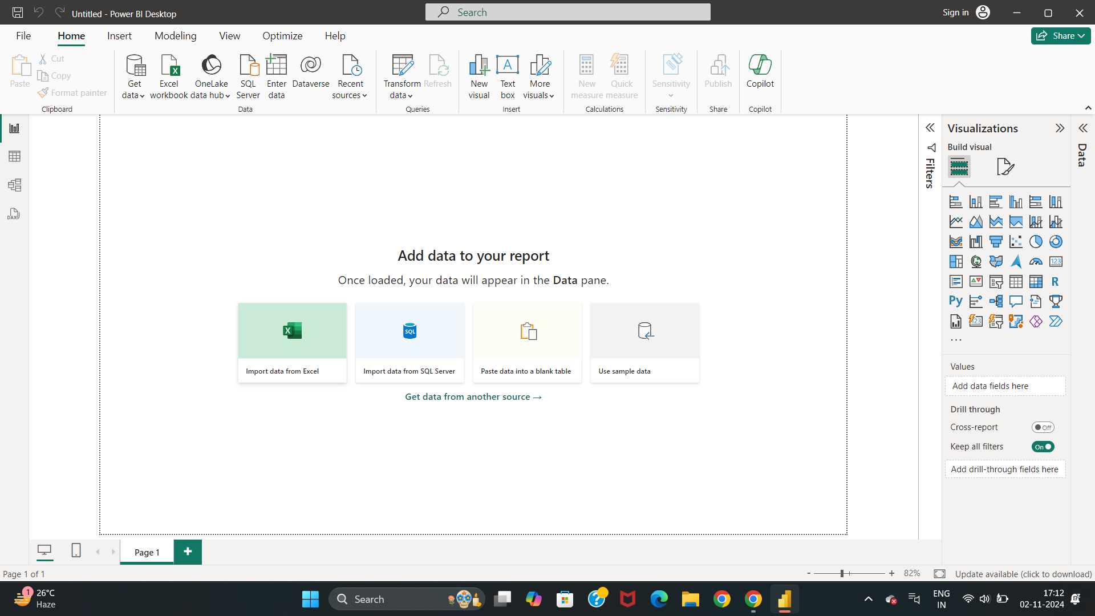
Click on Import data from Excel to open the excel file to get the data

Slide 5
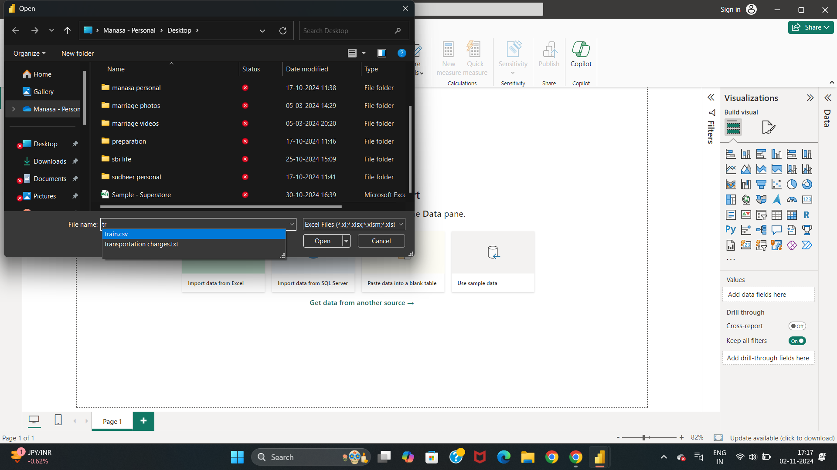
Click on Desktop
select the file name
Click on open
Notes:
Step 4: Click on Desktop and select the file to extract the data

Slide 6
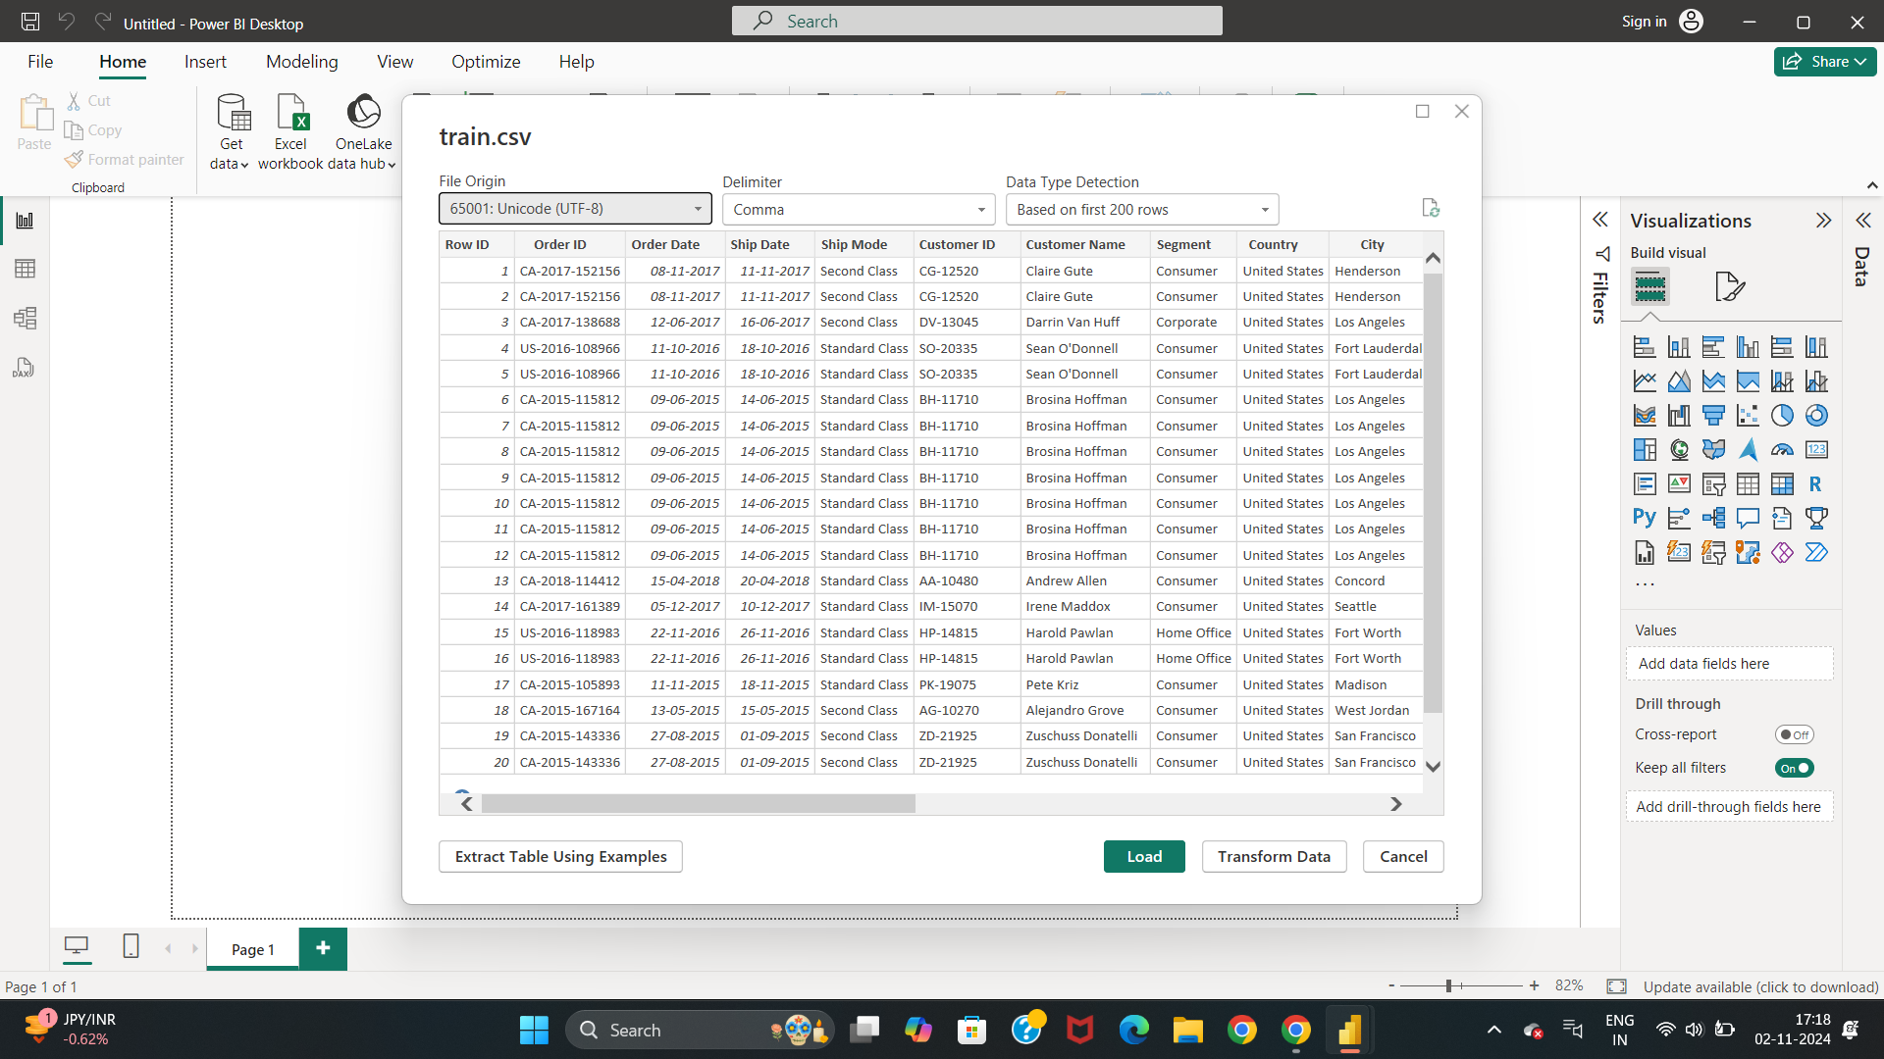
Click on Load to import the data to create a dashboard

Slide 7
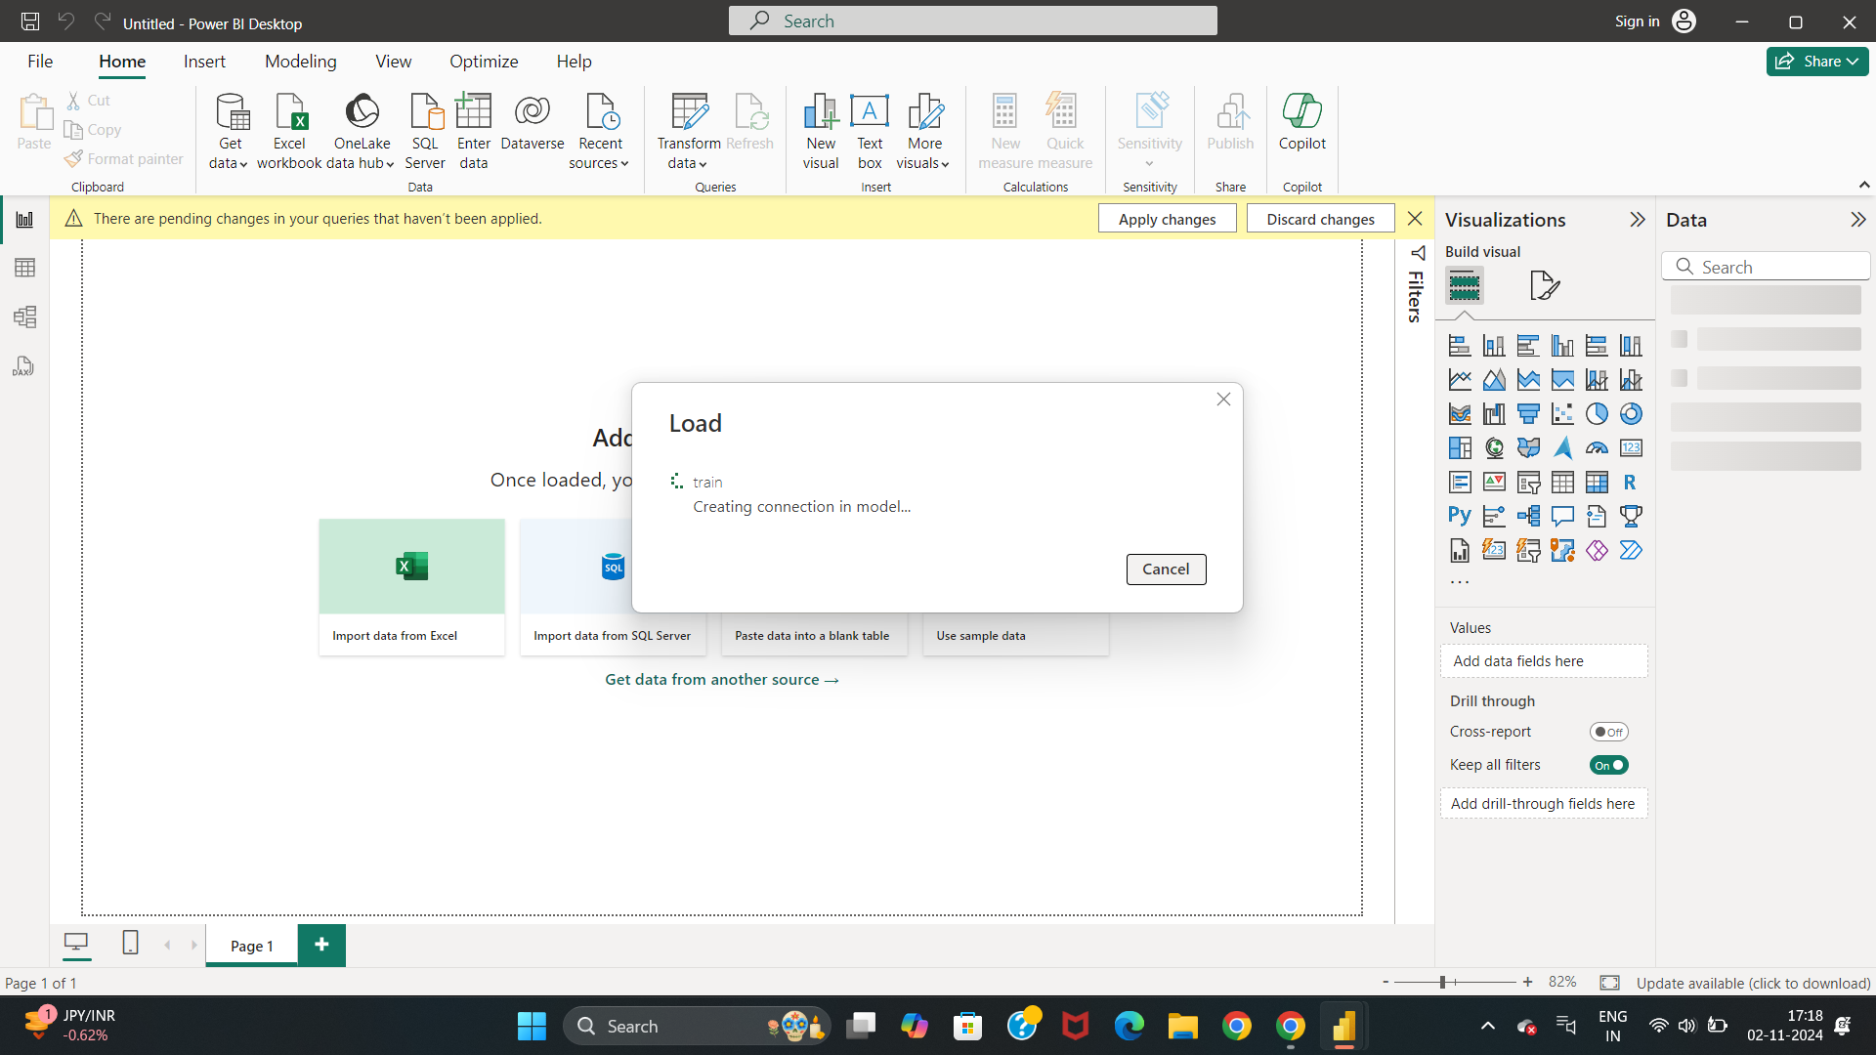
The data gets loaded for creating the dashboard

Slide 8
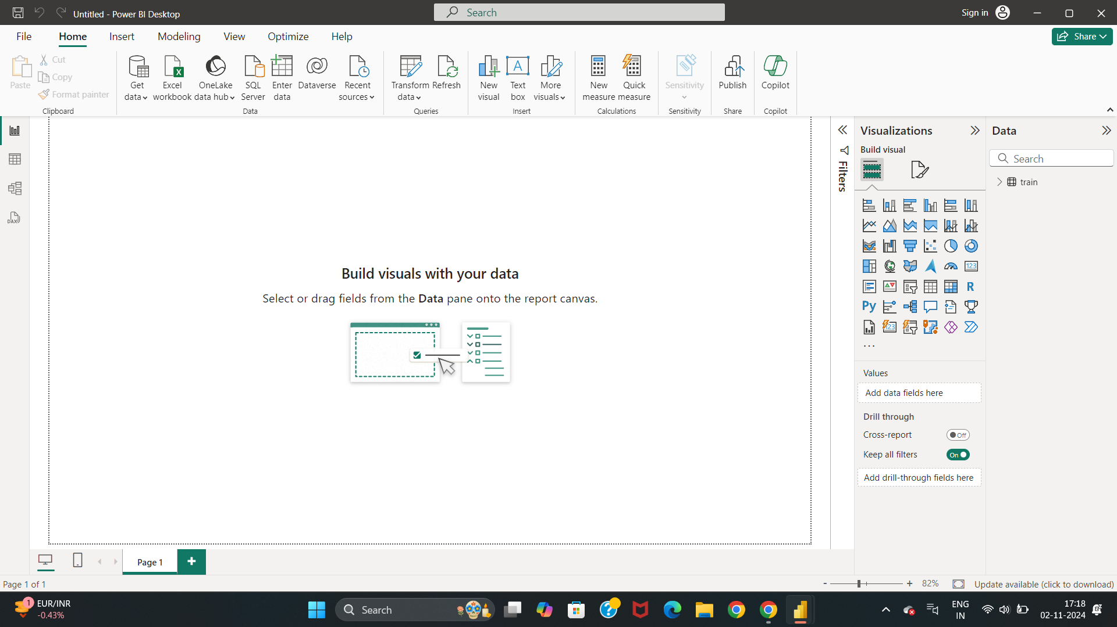
Click on train data logo in the right corner
Notes:
Step 7: Data gets loaded and here you will see train data logo in the right corner

Slide 9
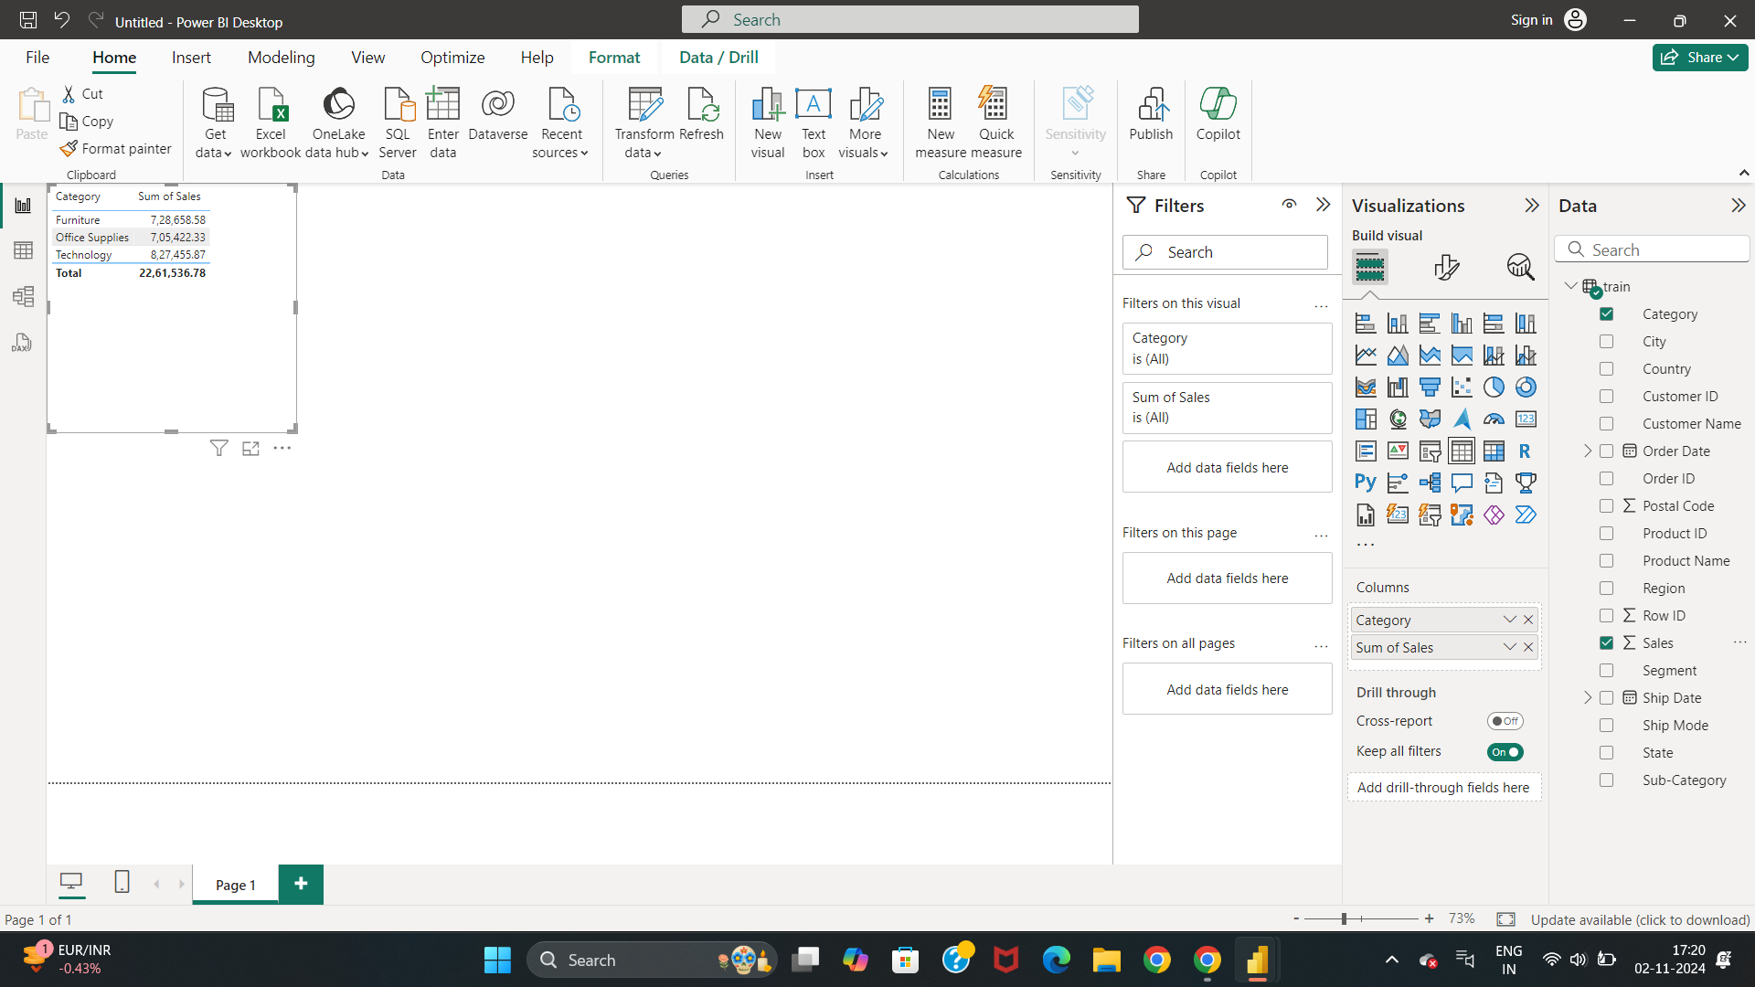
Drag and Drop the category and sales in the left side empty space to get the visualizations

Slide 10
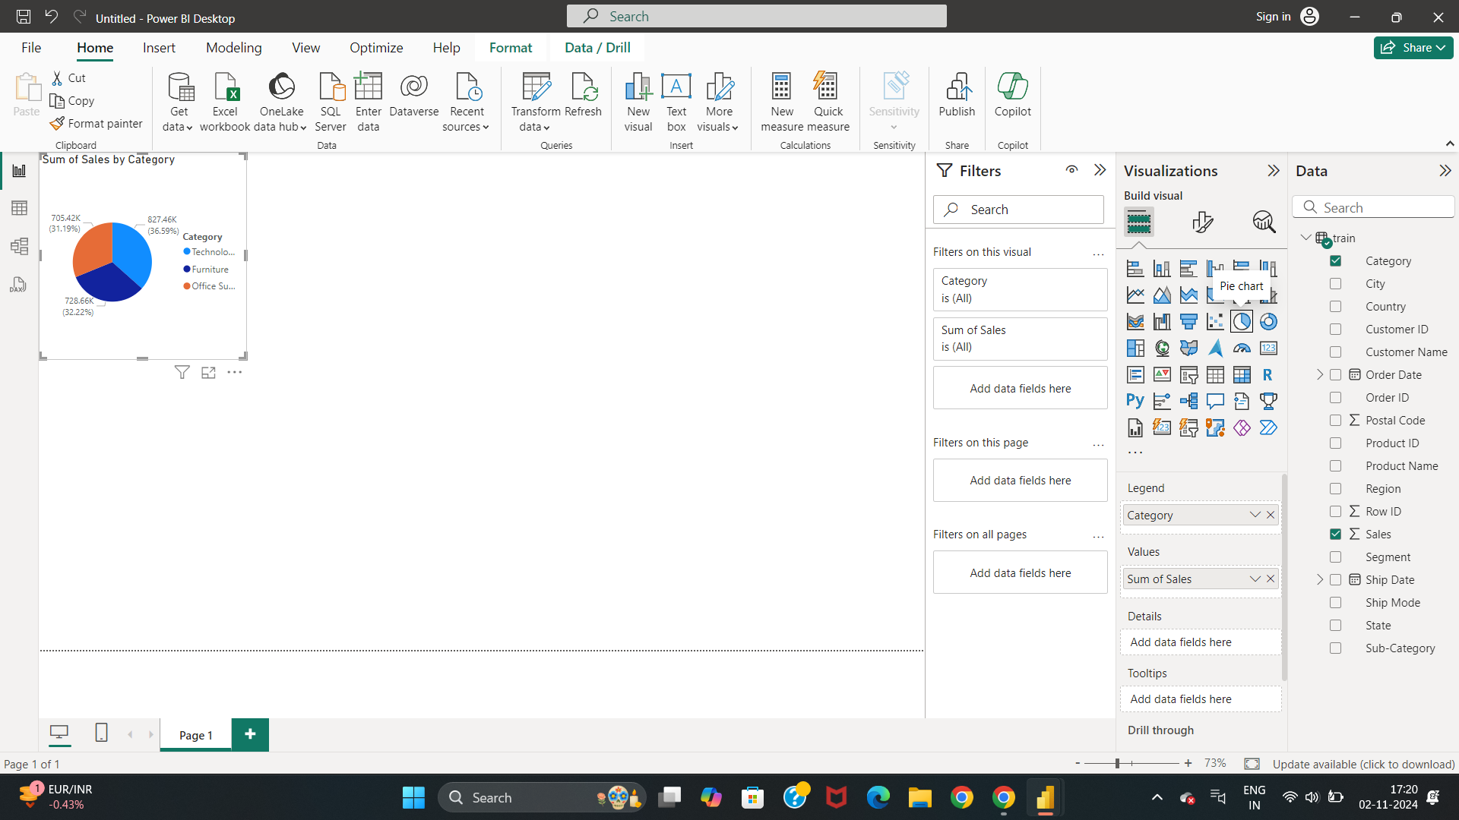
You can select the visuals to create the charts
Here, We have selected Pie Chart for getting the analysis of data regarding sum of sales by category

Slide 11
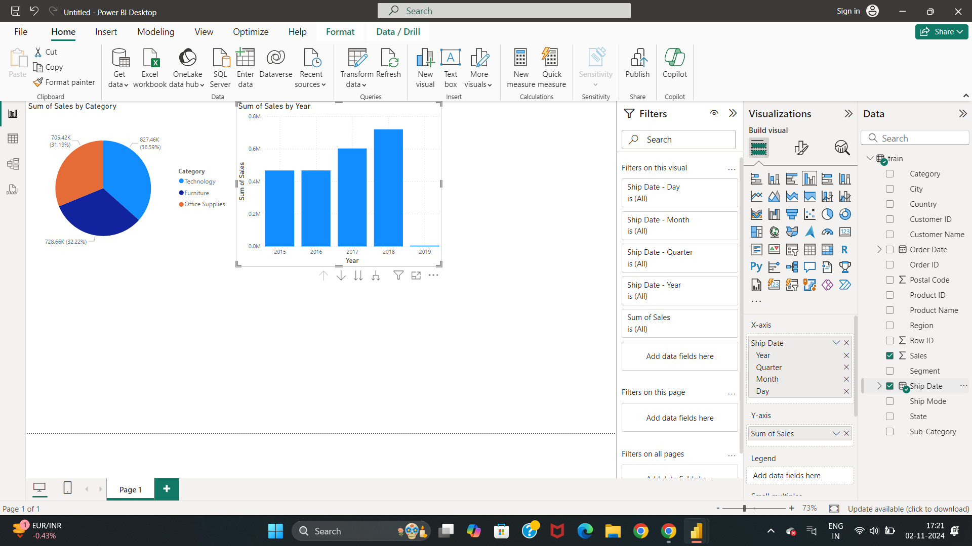
Drag and Drop the Sales and Ship date for getting the above graph

Slide 12
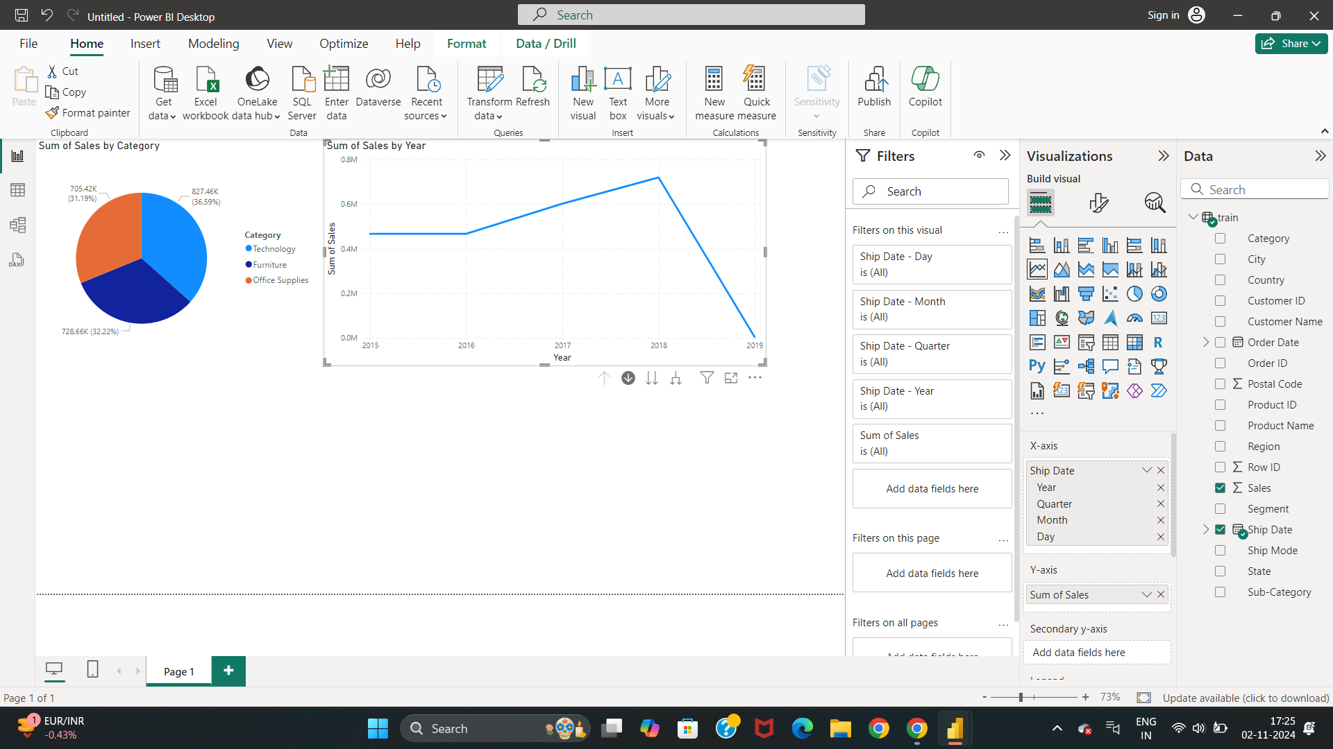
Here, we have selected Line Scatter graph to get the analysis visualization for sum of sales by year

Slide 13
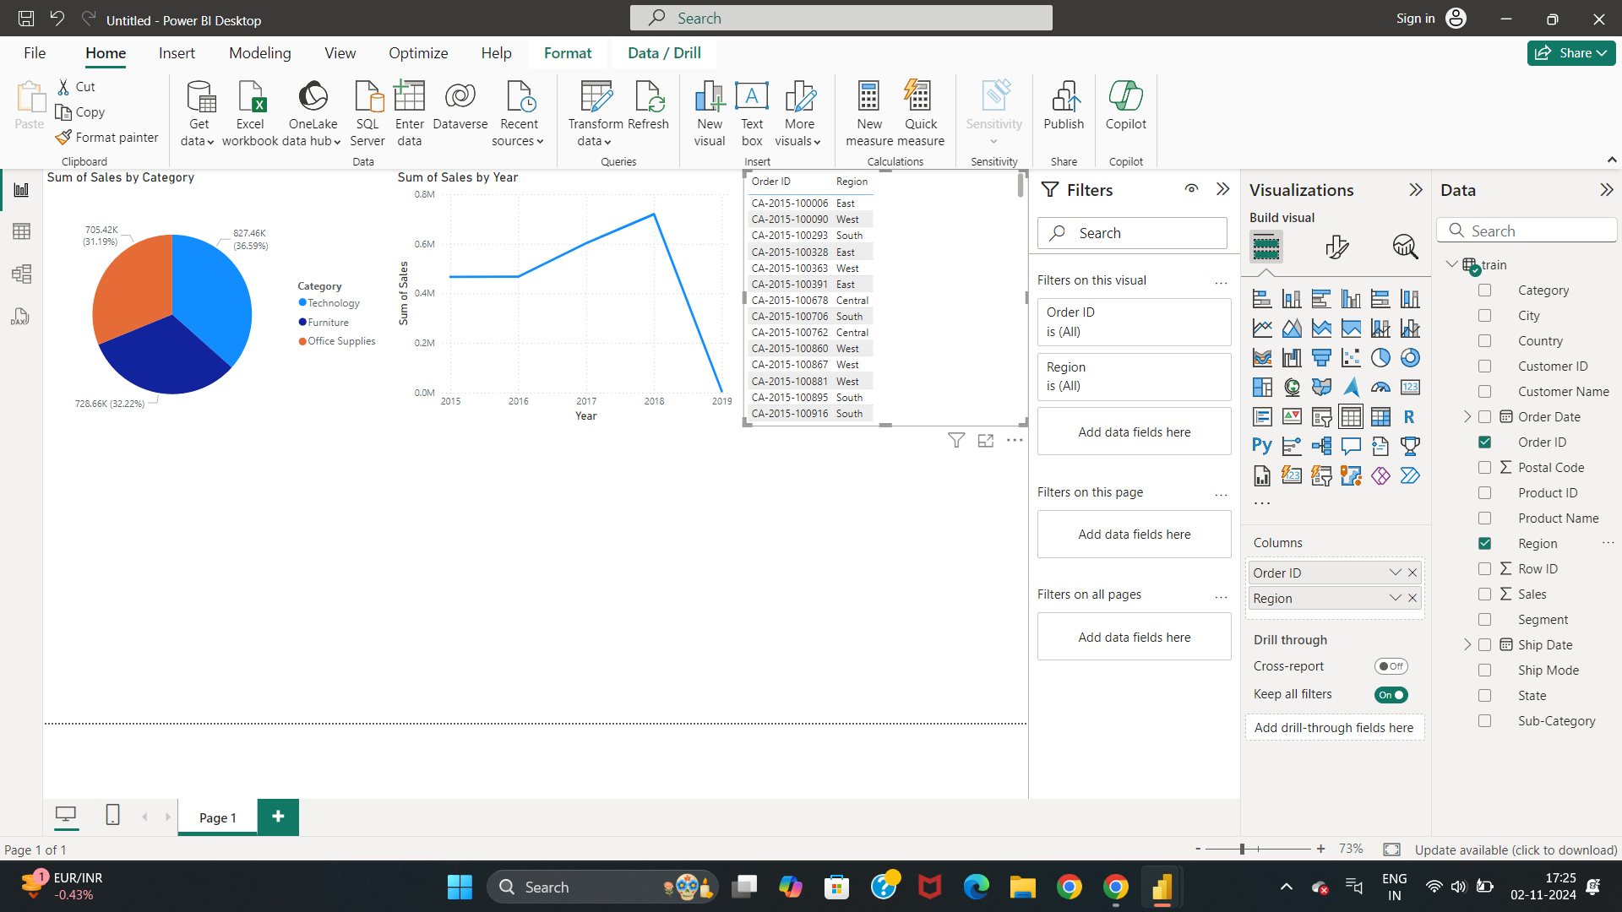
Drag and Drop order Id and Region to the left side window

Slide 14
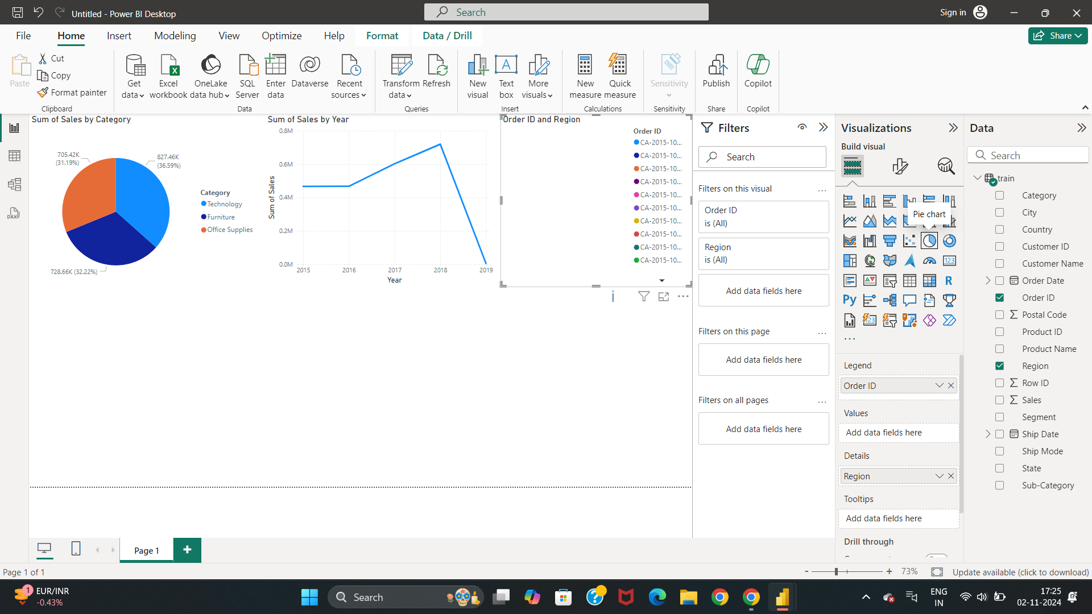
Here, We have selected Pie chart in visualizations to get the analysis for Order ID and Region

Slide 15
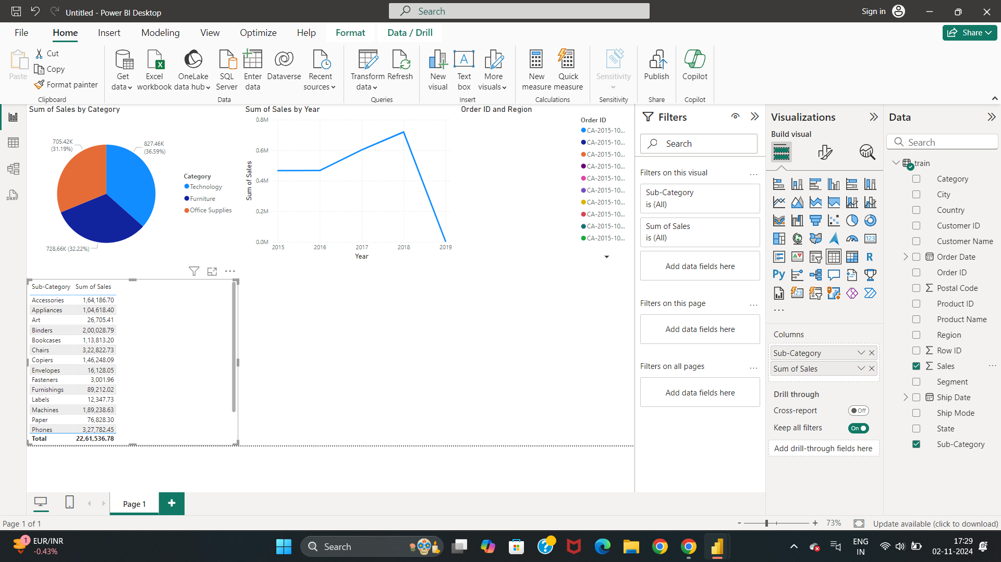
Drag and drop sales and sub-category fields

Slide 16
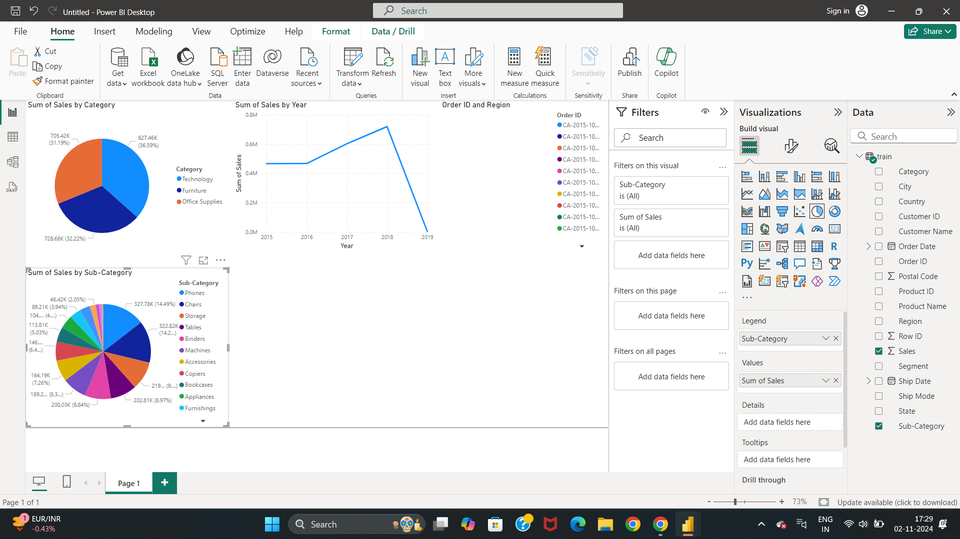
We have selected Pie chart in Build Visuals to get the analysis of data for sum of sales by sub-category

Slide 17
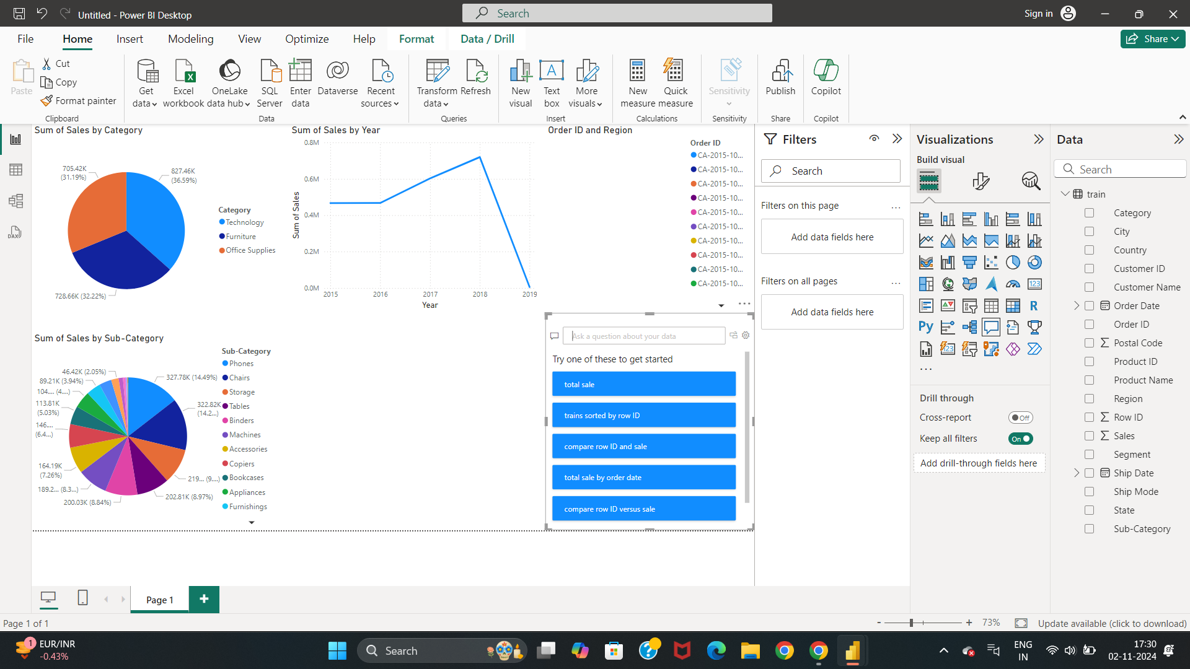
Double click on right button of the mouse to get this fields
Click on trains sorted by row ID

Slide 18
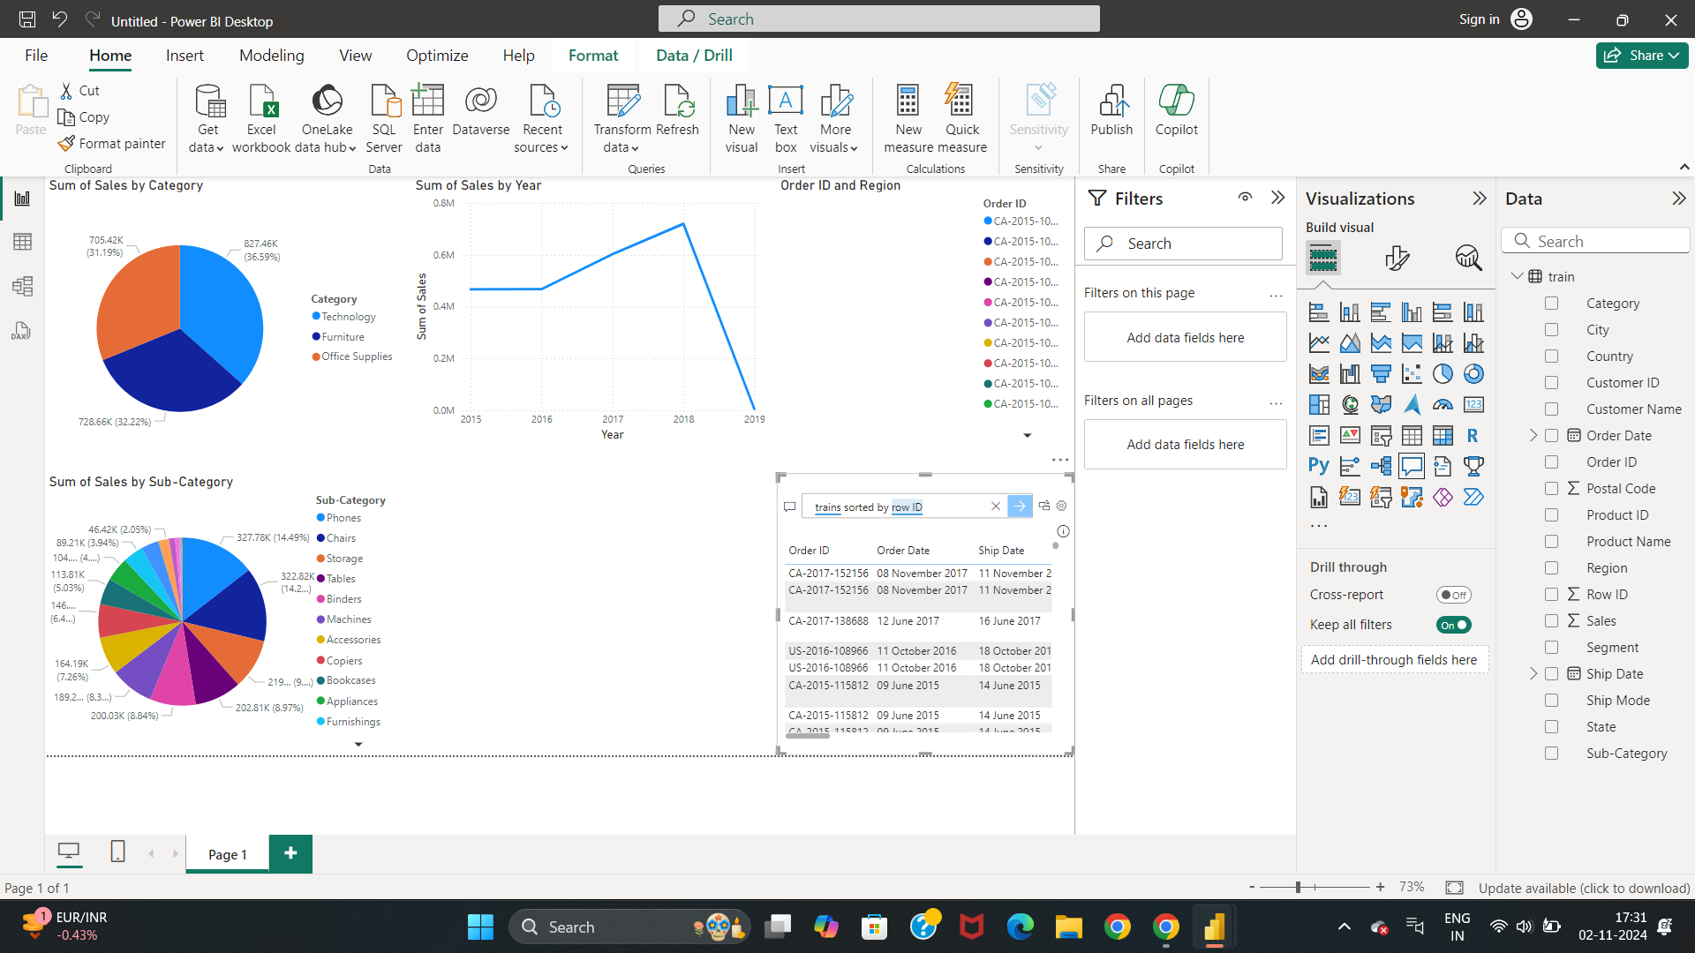
By selecting the “trains sorted by row ID”, we get this data

Slide 19
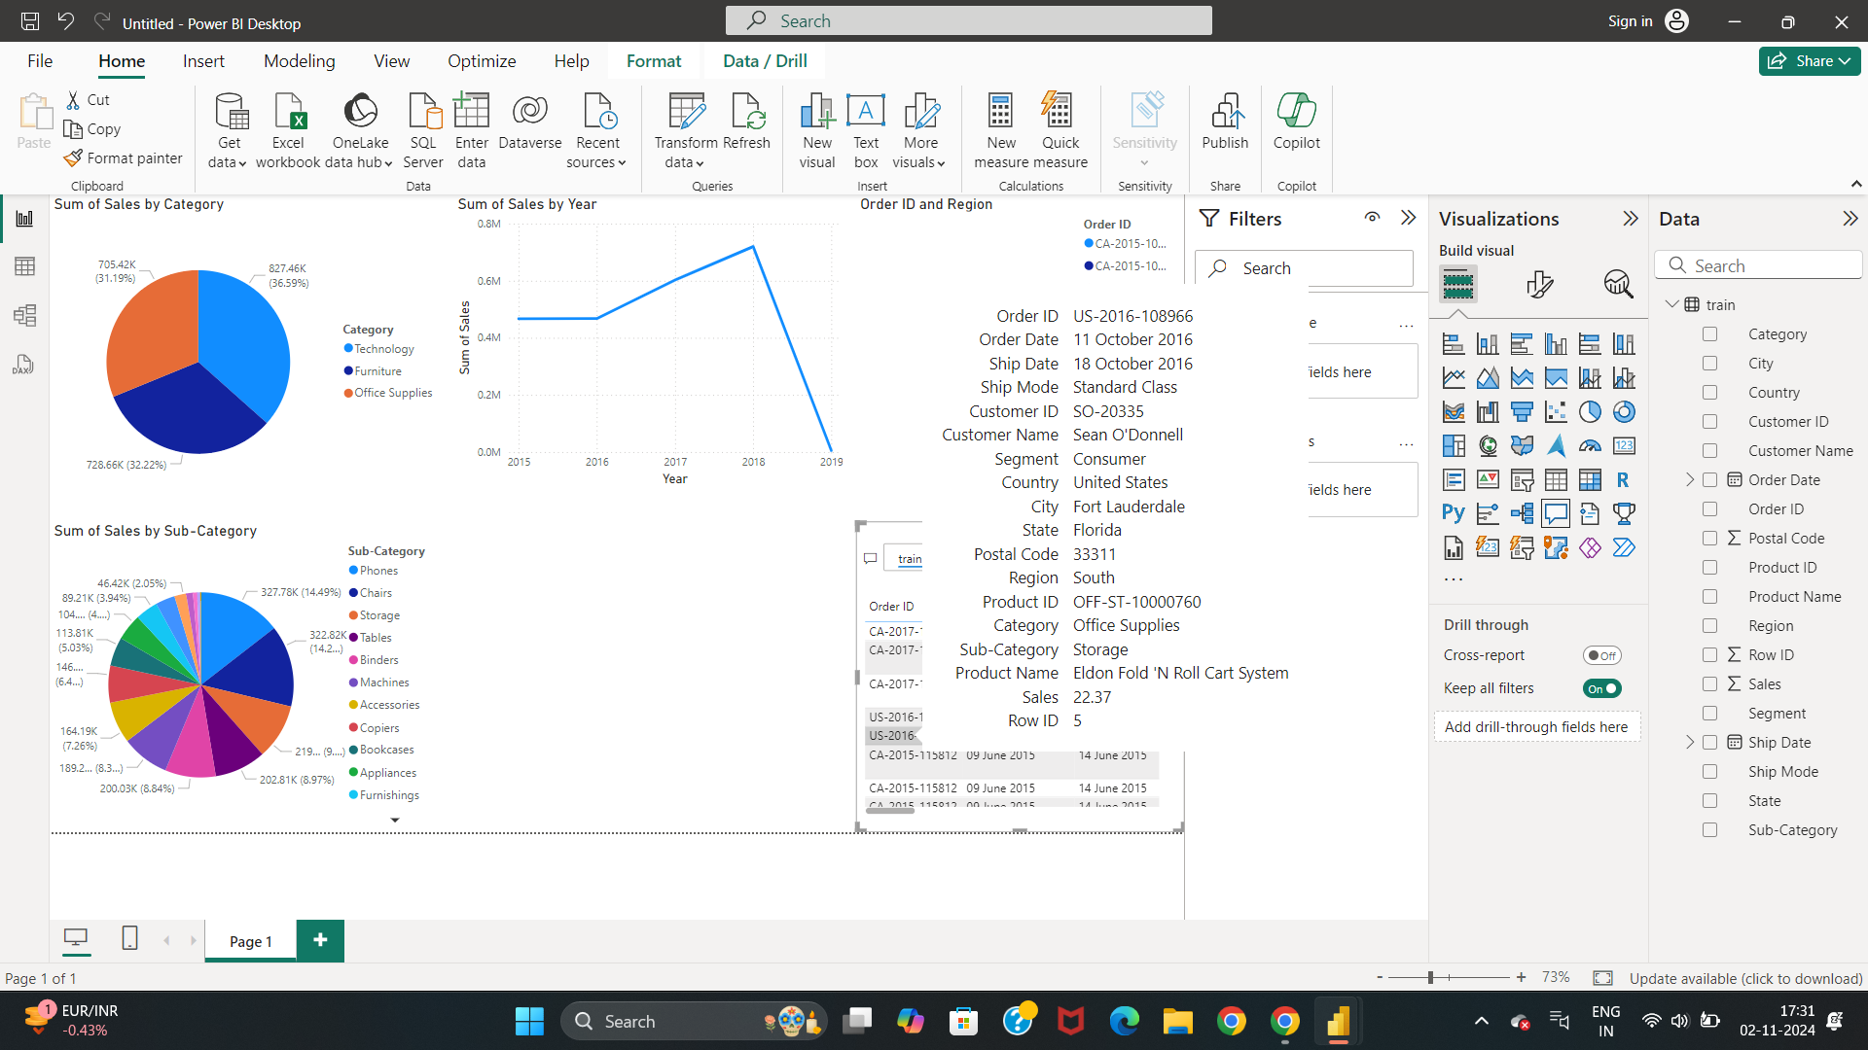
By placing the cursor on order ID, we get the complete details of “order ID, ship date, city, sales” etc.

Slide 20
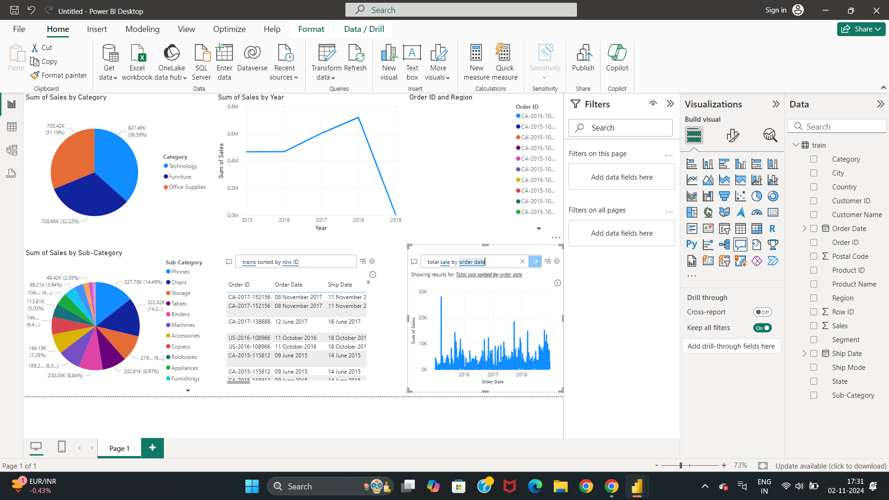
From the above one, We have choosen “total sales by order date” to get the data related to sales

Slide 21

By placing the cursor on the graph, we can get the data of sales with date, month and year
Click on File option to save the file

Slide 22
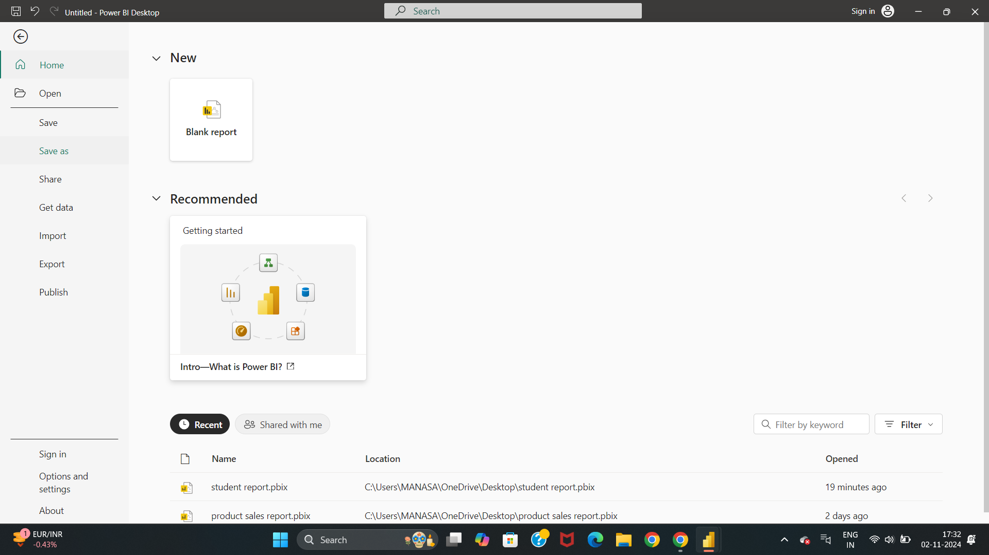
Click on save as option for saving the file

Slide 23
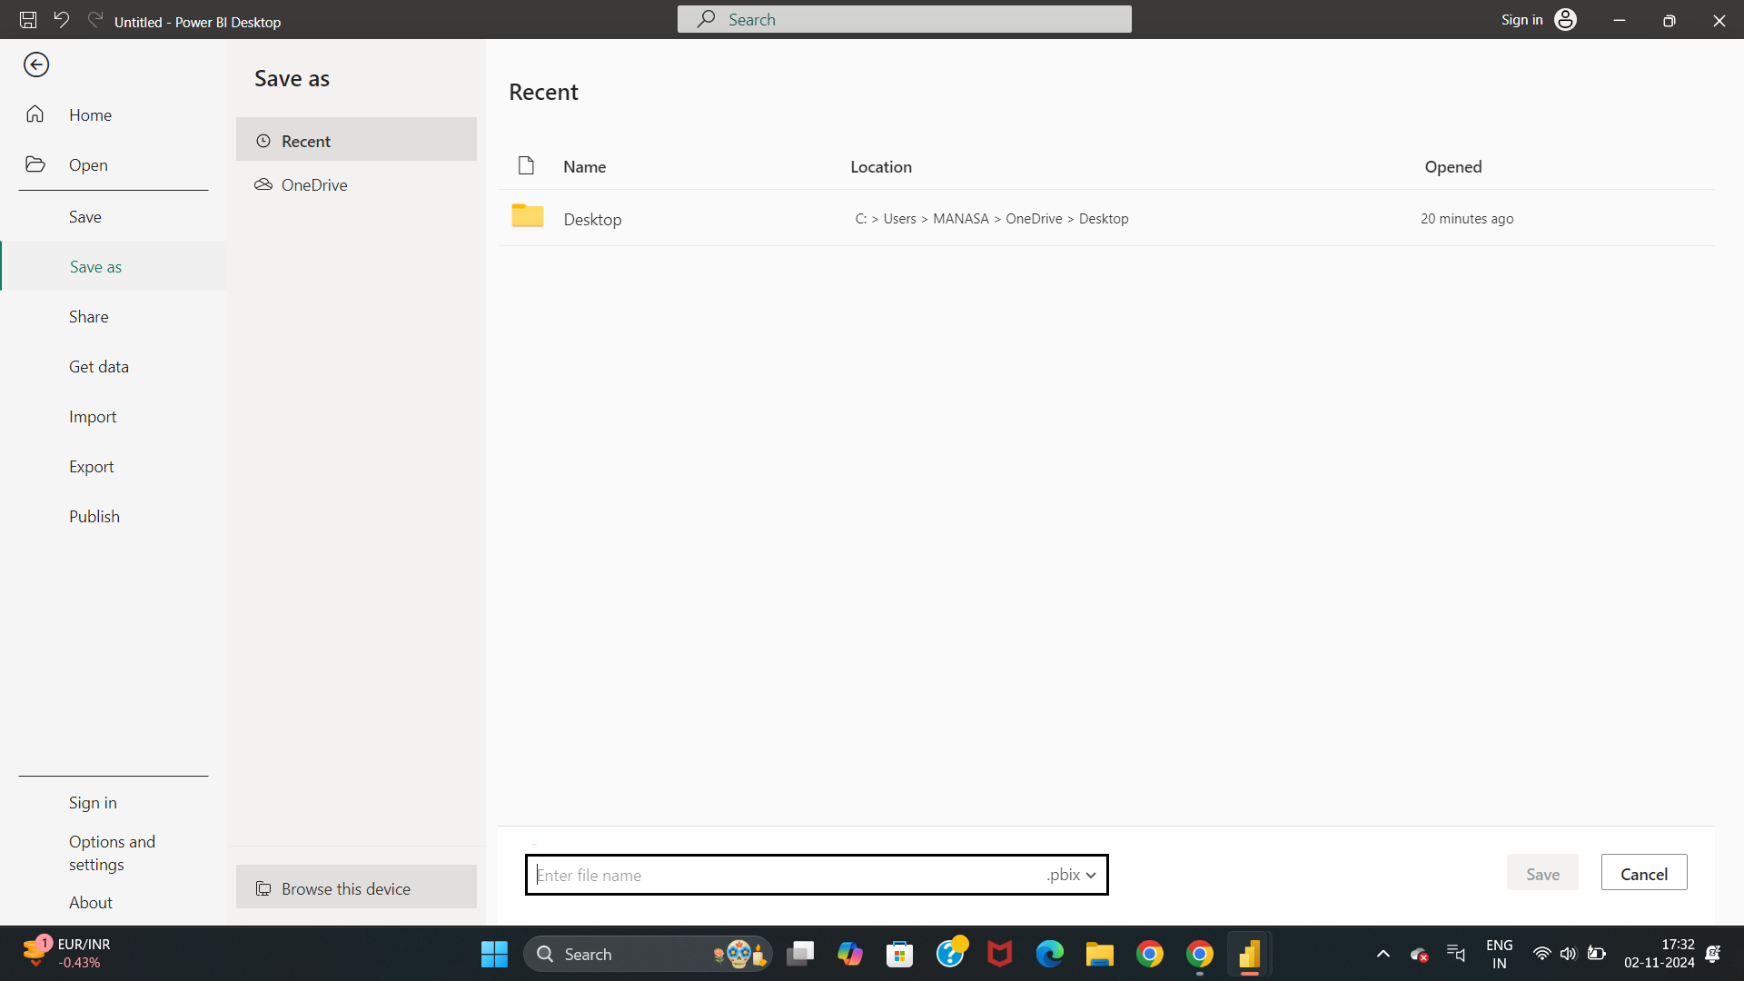
Select the “Browse this device” for saving the file

Slide 24
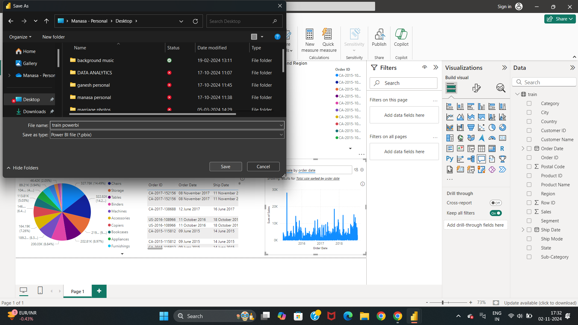
Give a file name to the file
Click on save to save the file
Click on desktop option
Notes:
Step 24: Select the Desktop option, give the file name in the “File Name” option and click on save to save the file

Slide 25


